Slide 1

Azure Sentinel
For PowerShell Scripters
^{Josh King ( @WindosNZ )}
^{V1.1}

Slide 2
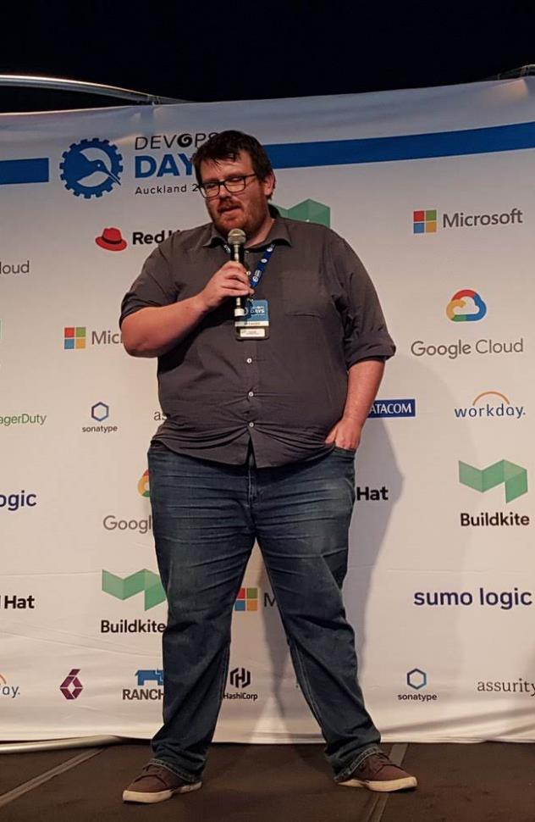

HELLO
JOSH KING
Systems Administrator @ Tribe
Microsoft MVP: Cloud and Datacenter Management
@WindosNZ ToastIT.dev

·

Slide 3





What is
Azure Sentinel
Cloud Based SIEM
With a dash of AI and the benefit of easy integration with Azure services
Detect
Investigate
Collect
Respond
Notes:
Collect data at cloud scale—across all users, devices, applications and infrastructure, both on-premises and in multiple clouds.
Detect previously uncovered threats and minimise false positives using analytics and unparalleled threat intelligence from Microsoft.
Investigate threats with AI and hunt suspicious activities at scale, tapping into decades of cybersecurity work at Microsoft.
Respond to incidents rapidly with built-in orchestration and automation of common tasks.

Slide 4

What’s
The
Cost?
$2.46 per GB-ingested
+ $2.76 per GB for Log Analytics, after 5 GB free per month
+ $0.12 per GB per month if more than 90 days retention is needed
https://azure.microsoft.com/en-in/pricing/details/azure-sentinel

Slide 5

Number 8 Wire
Mentality
Notes:
As a consequence of the ubiquitous use of number 8 wire in New Zealand, remote farms often had rolls of number 8 wire on hand, and the wire would often be used inventively and practically to solve mechanical or structural problems other than fencing.^{[5]} Accordingly, the term "number 8 wire" came to represent the ingenuity and resourcefulness of New Zealanders,^{[6][7]} and the phrase "a number 8 wire mentality" evolved to denote an ability to create or repair machinery using whatever scrap materials are available on hand.^{[8]}

Slide 6



Demo
Setup workspace and OOB connections / alerts

Slide 7
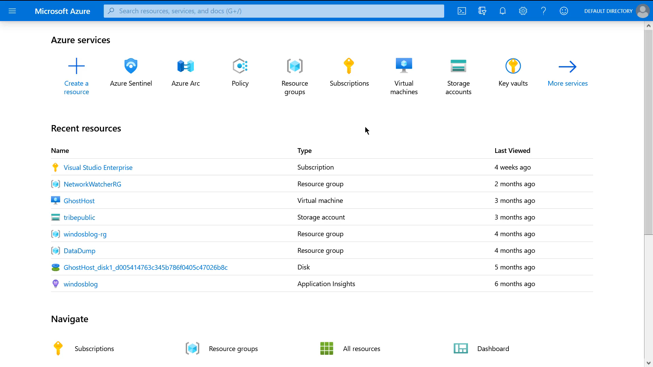

Slide 8
Demo
Sending random data from PowerShell

Slide 9
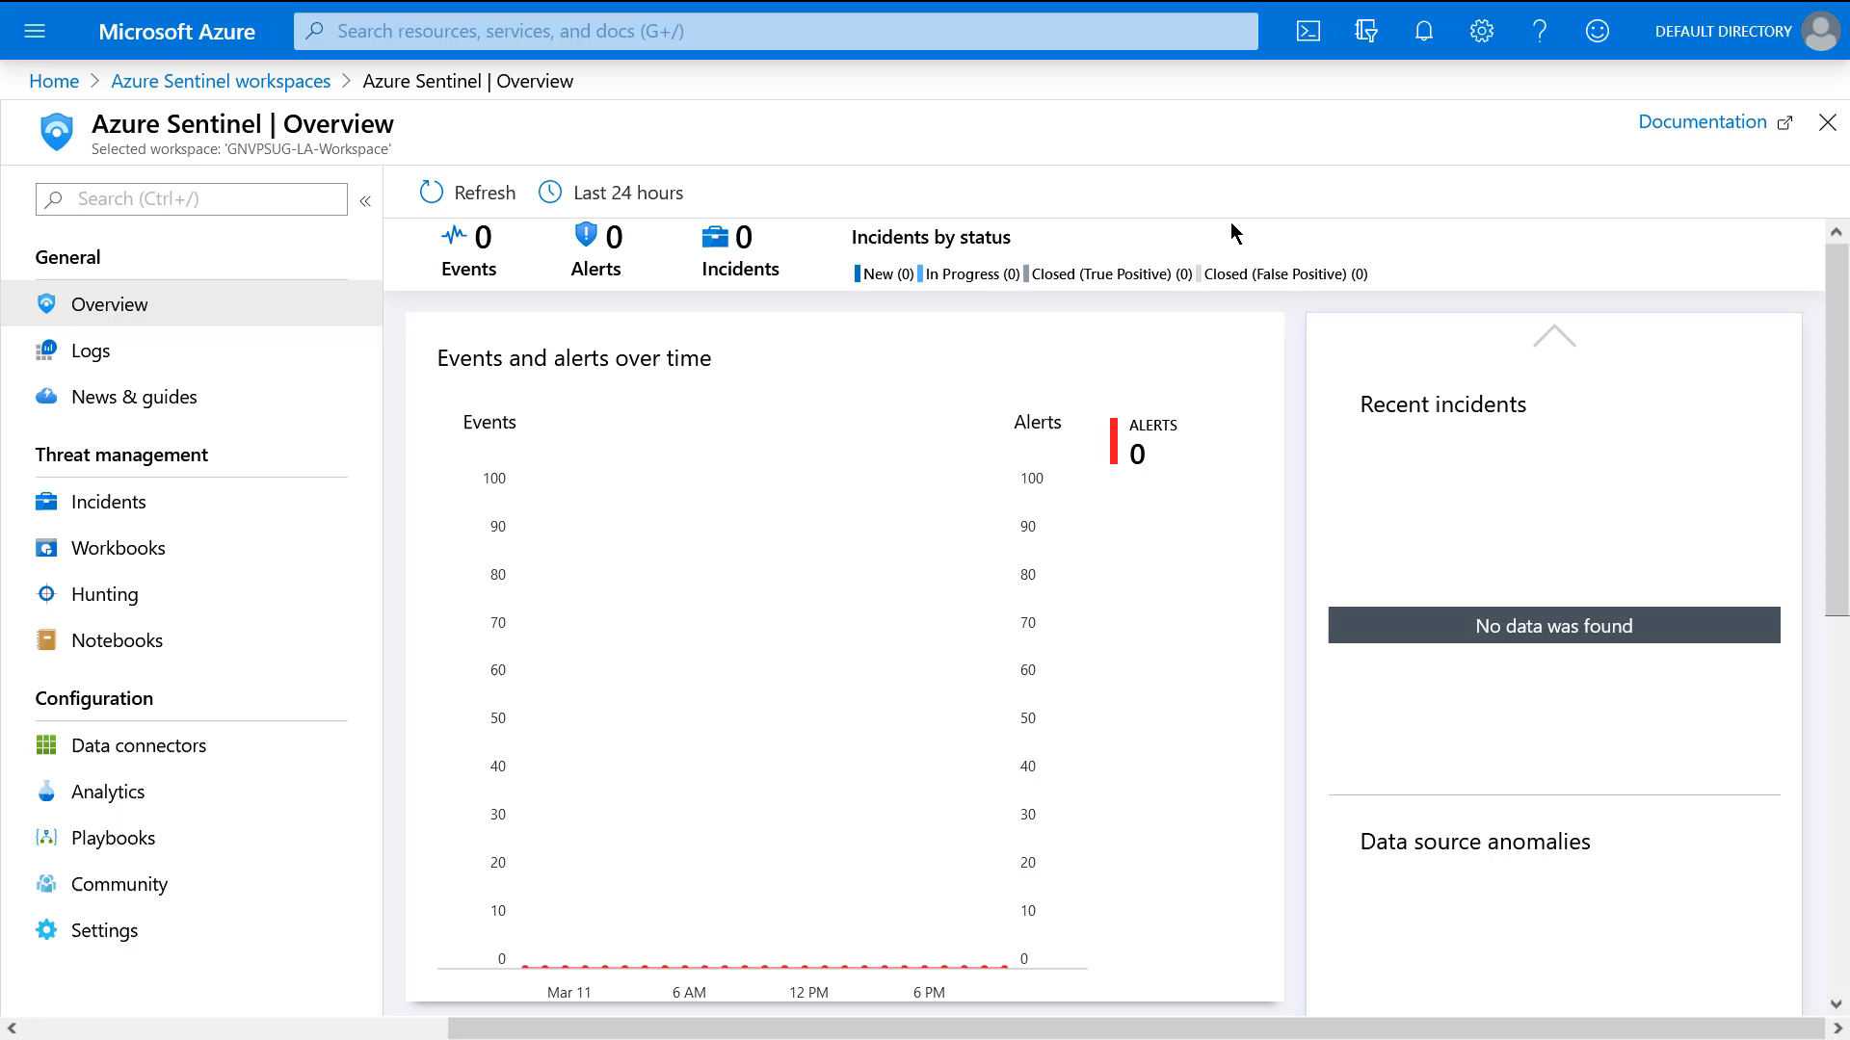

Slide 10
Demo
Logging function and scheduled job

Slide 11
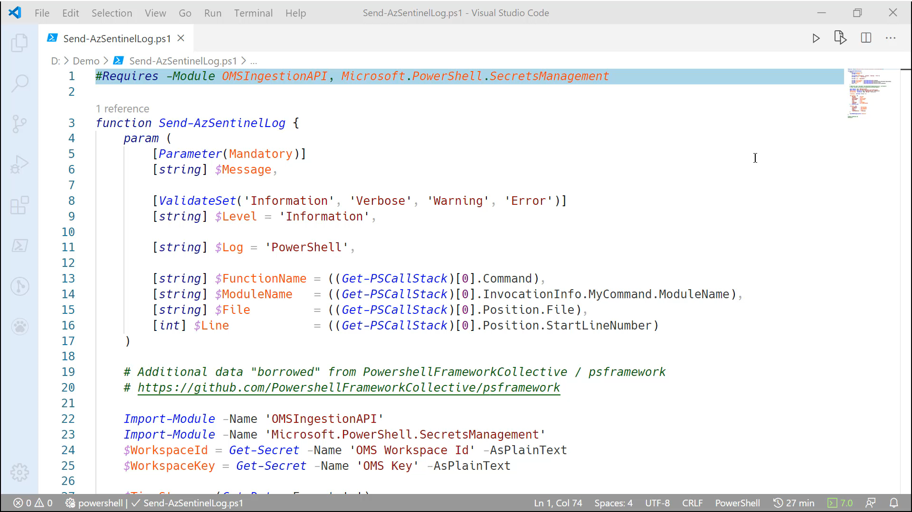

Slide 12
Demo
And now… the automation!

Slide 13
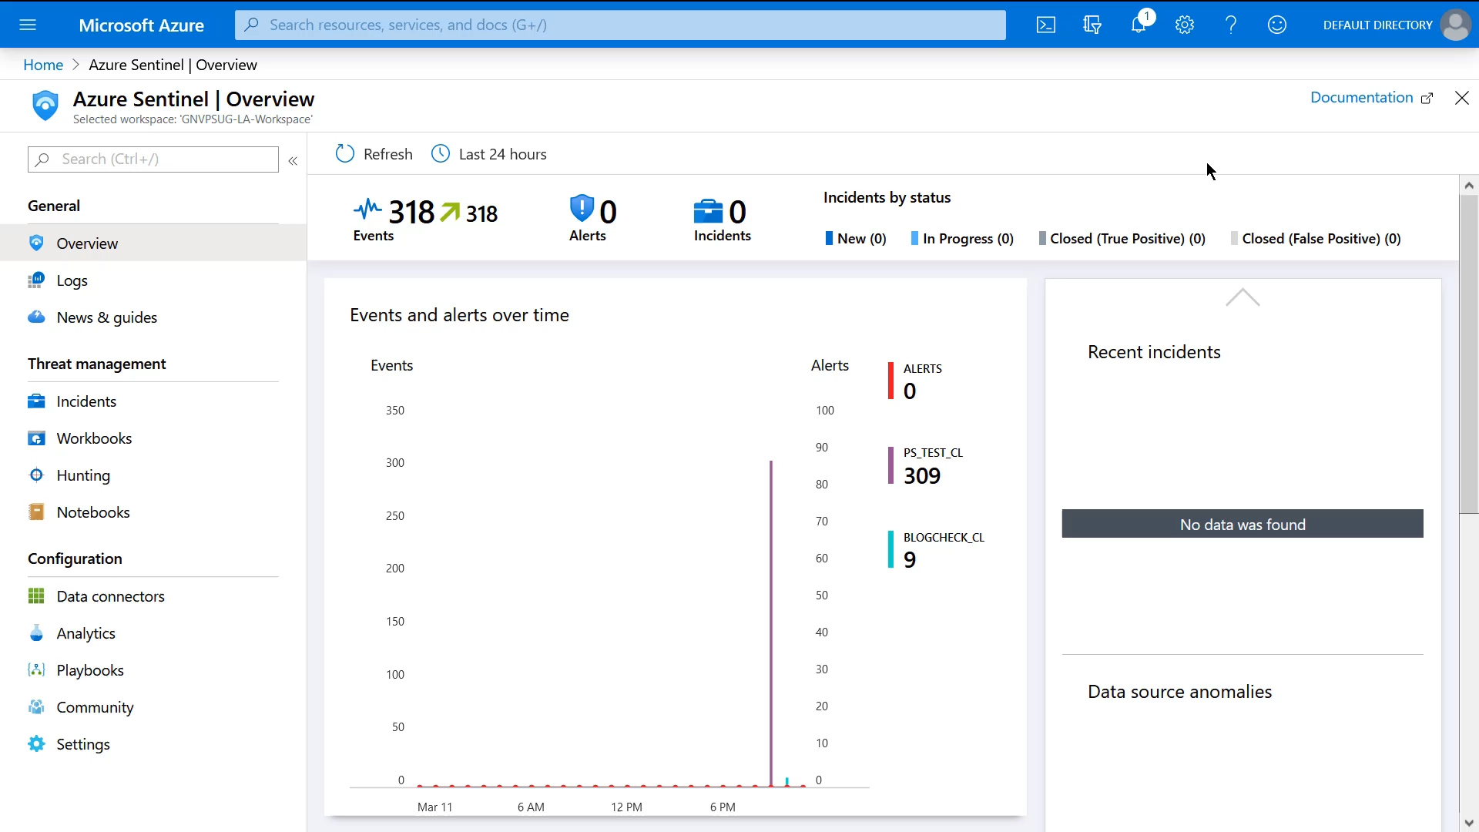

Slide 14
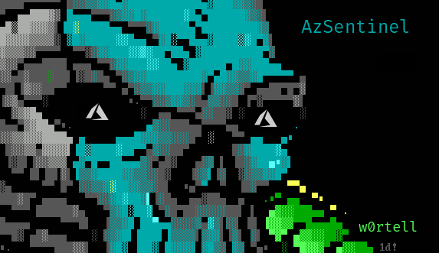

Slide 15

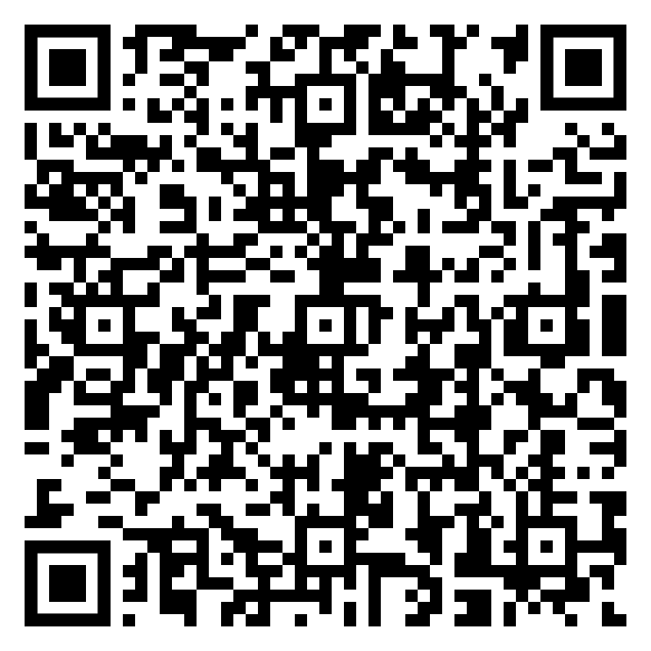
Thank
You!
Get in touch:
@WindosNZ
https://github.com/Windos/Talks

